Slide 1
Sachs and Warner 1995, 1997,2002
Natural Resource Abundance and Economic Growth

Slide 2
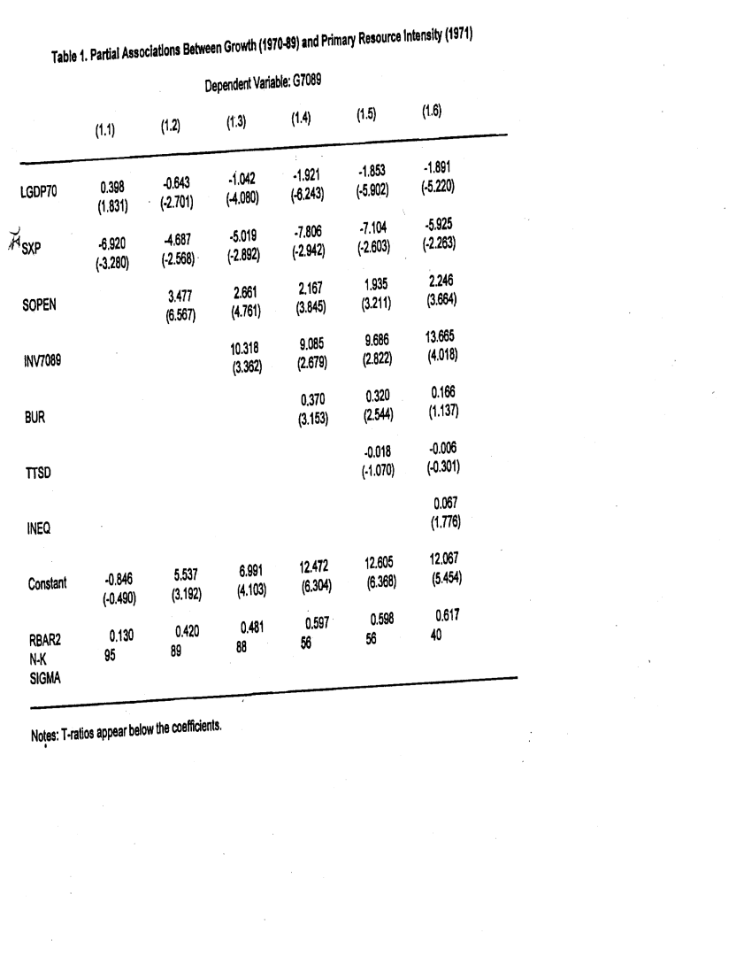

Slide 3
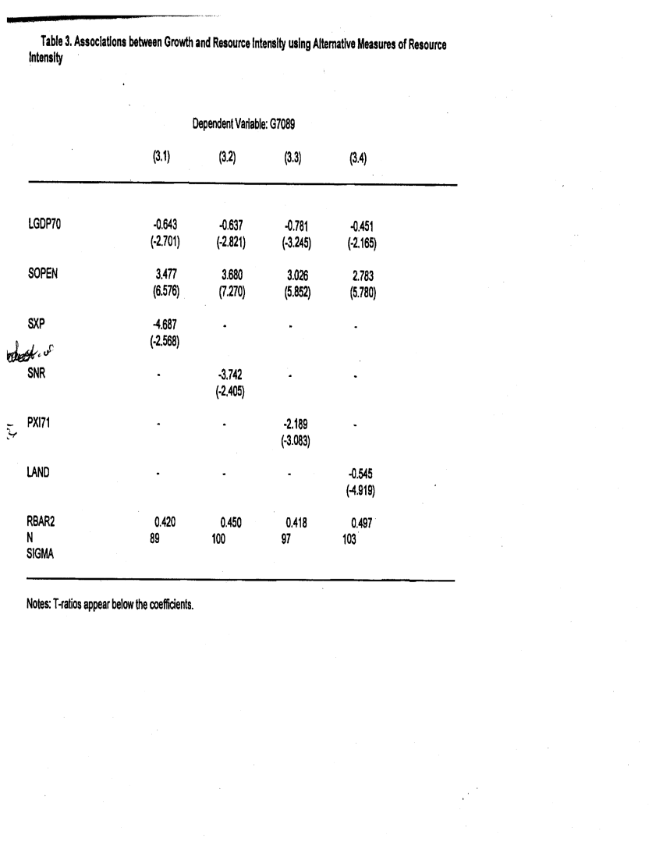

Slide 4
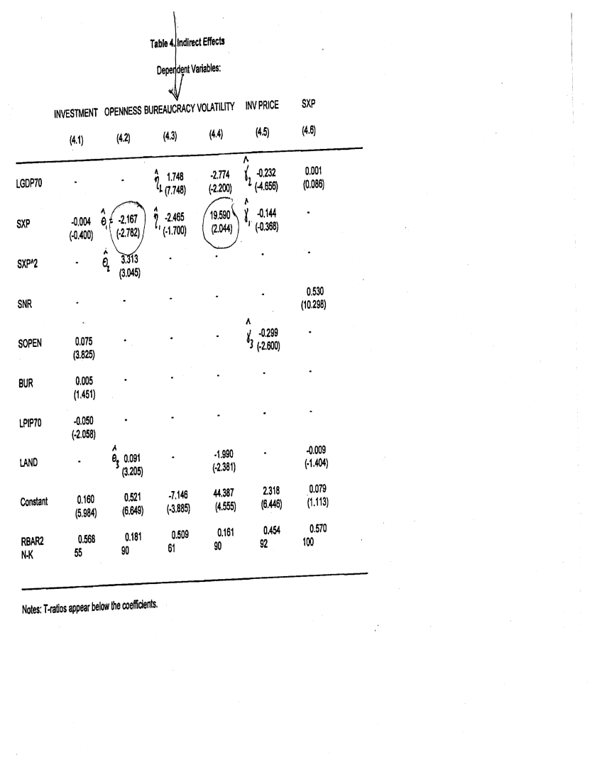

Slide 5
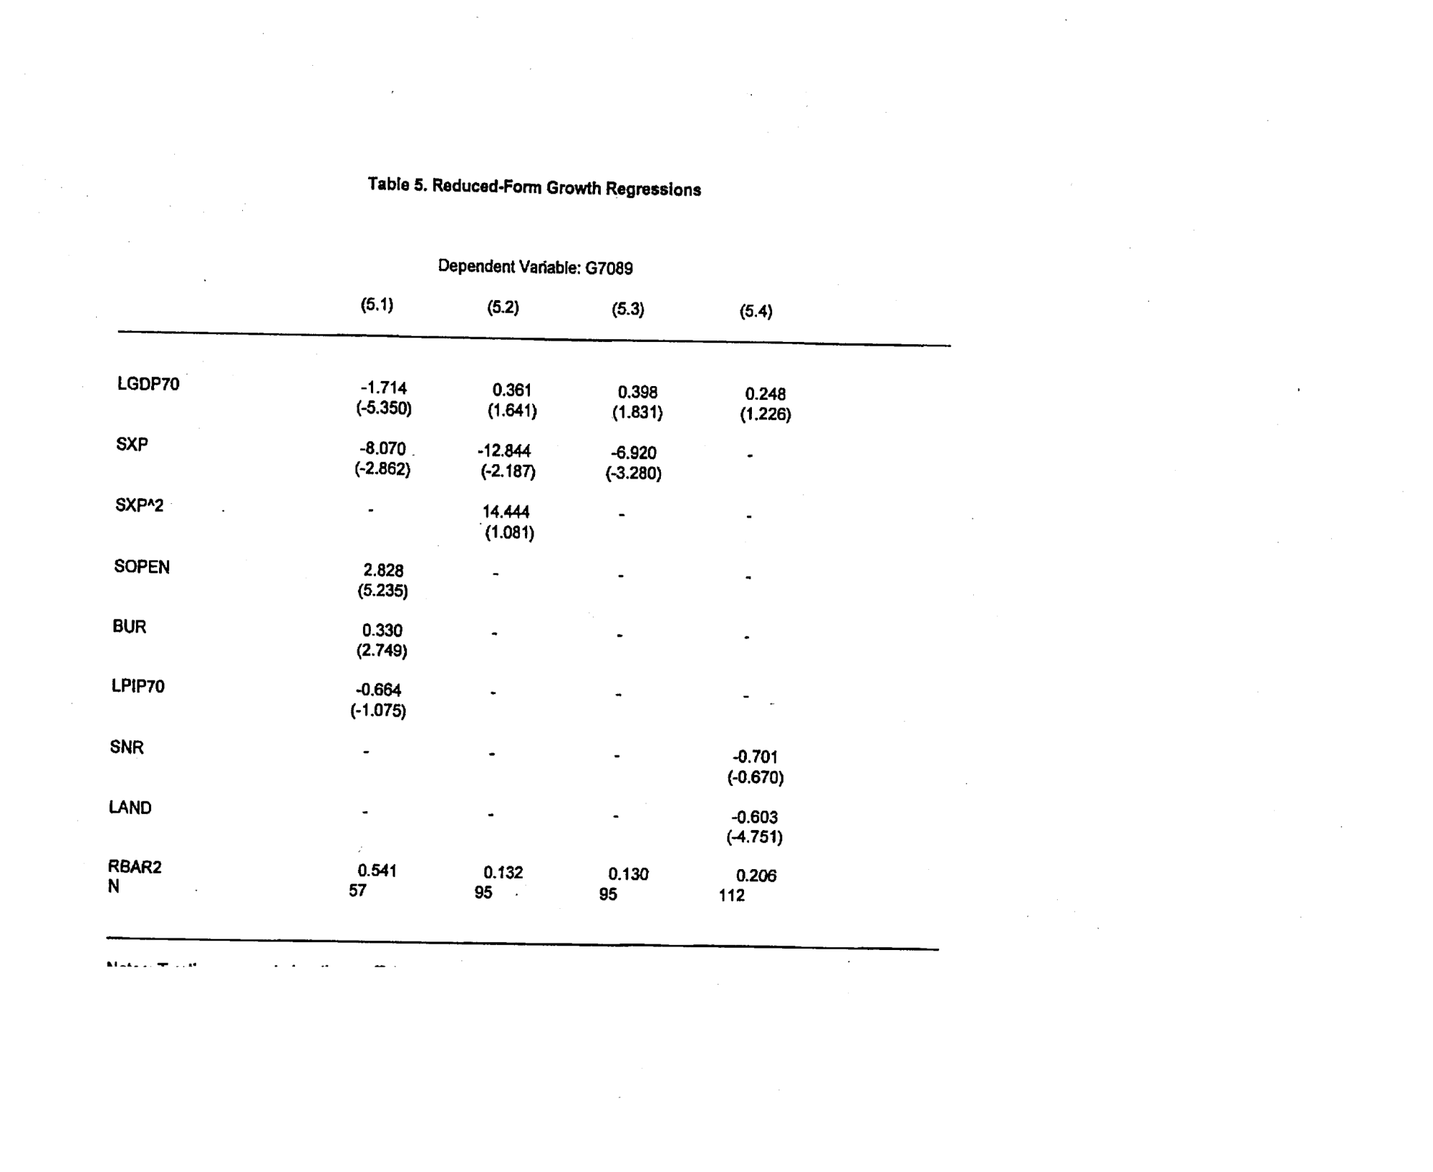

Slide 6
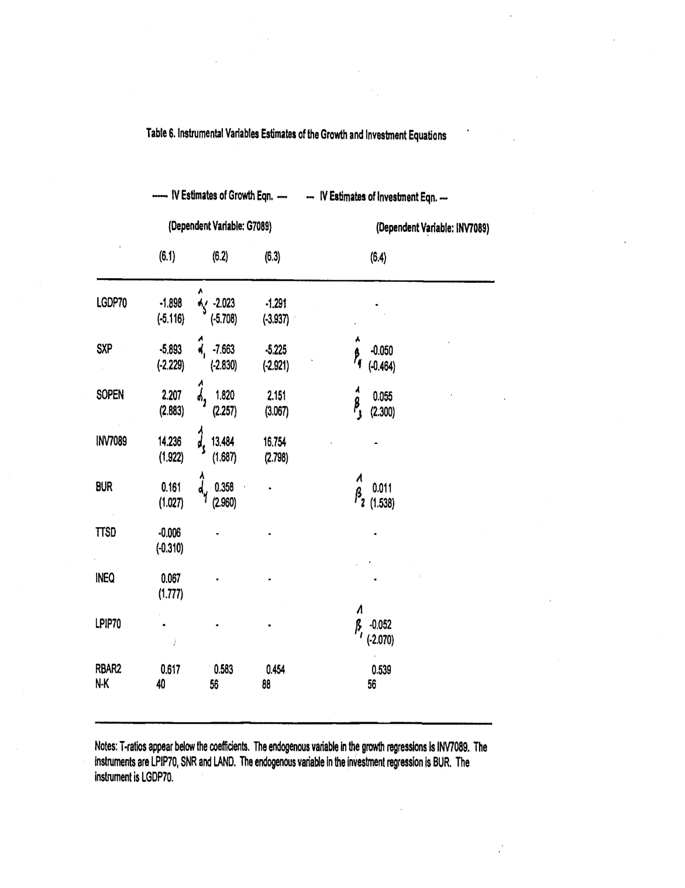

Slide 7
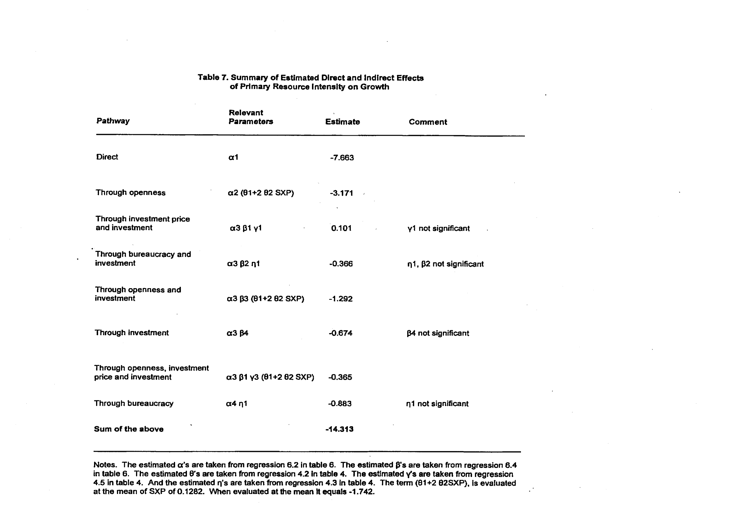

Slide 8
Other Controls and Links
Geography
Disease
Lagged Growth (1960s)
Exchange rates and inflation
Why Not More with Volatility?

Slide 9
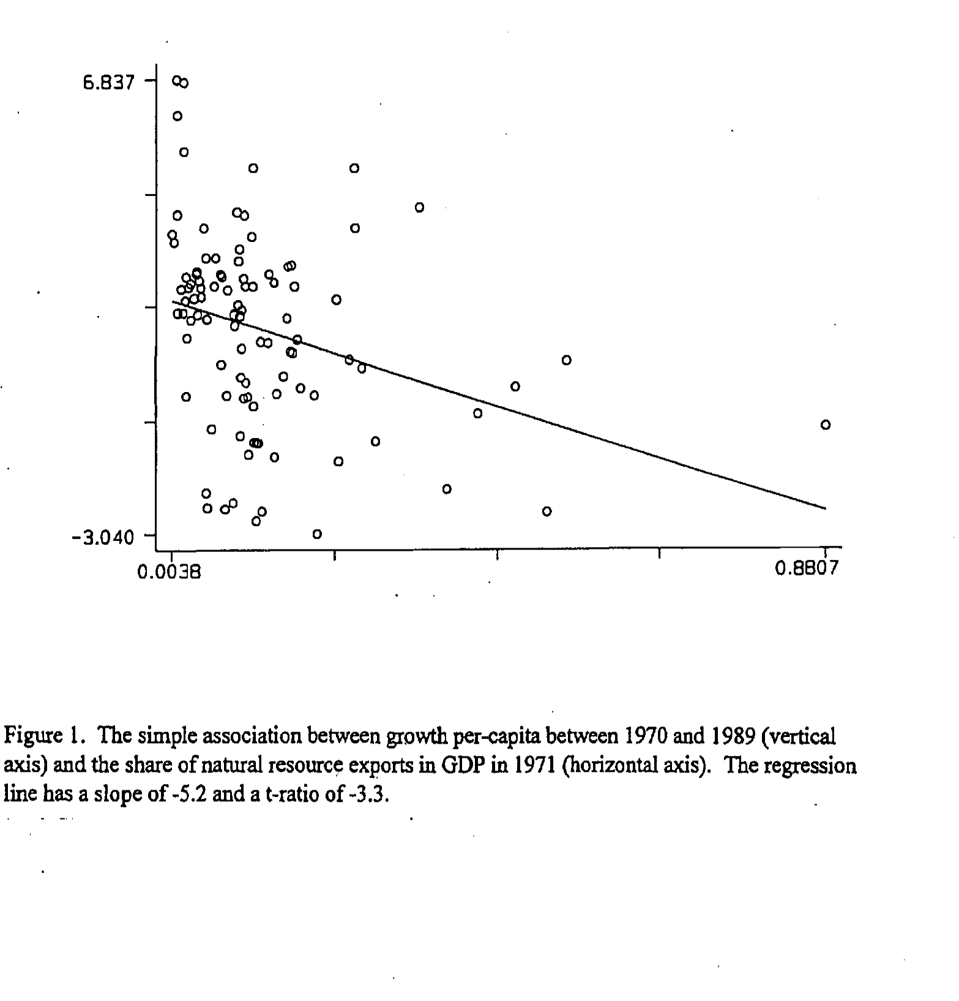

Slide 10
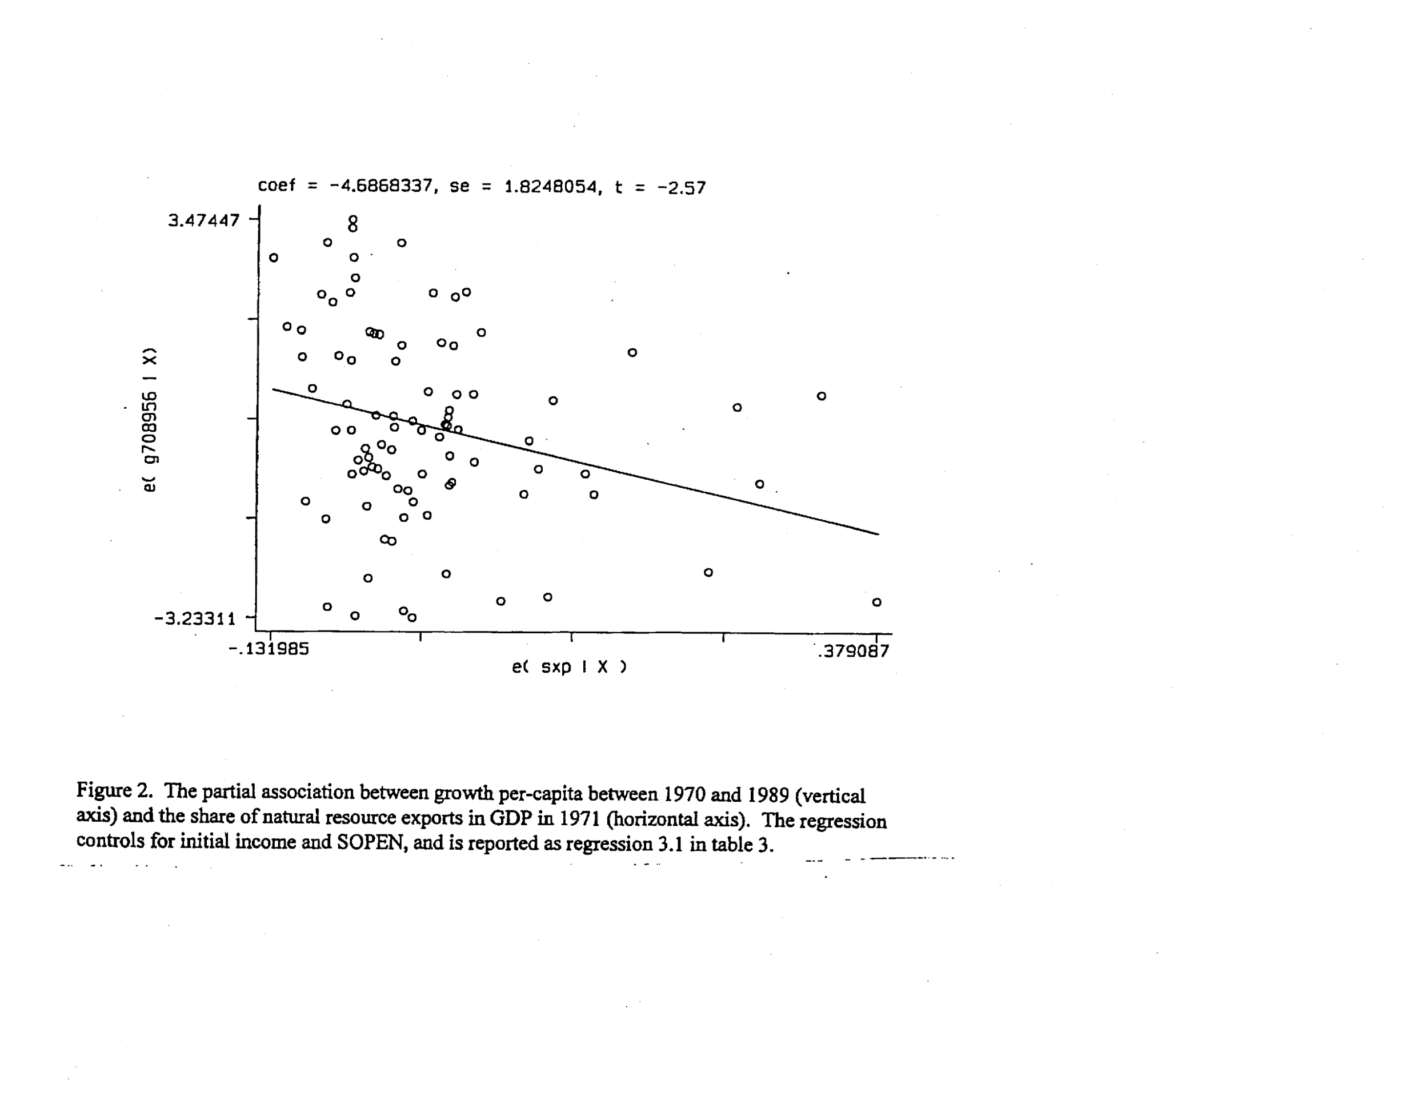

Slide 11
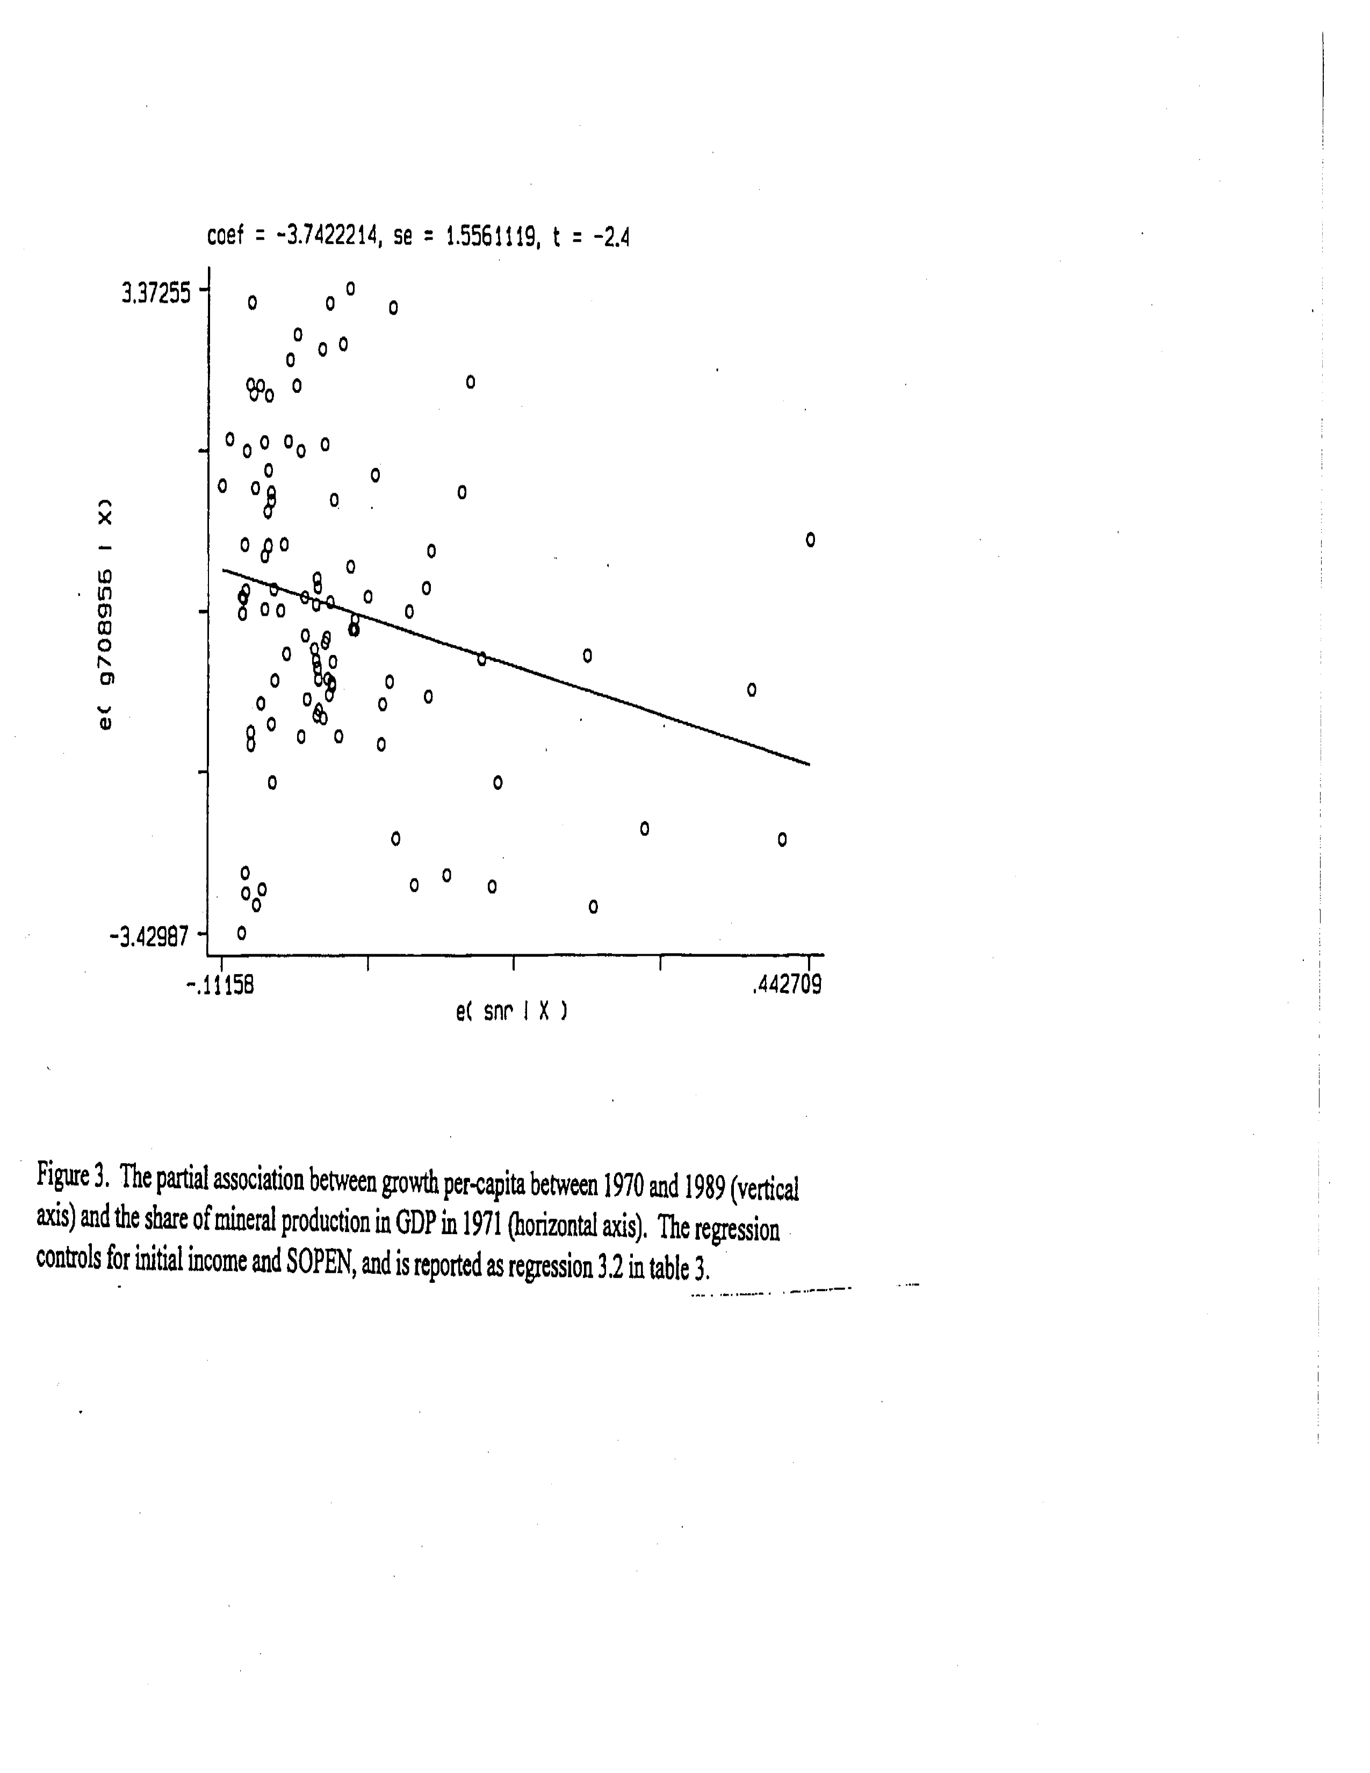

Slide 12
Mehlum, Moene and Torvik
Institutions and the Resource Curse
Economic Journal 2006
There are cases where curse is evident and those where it is not
Thesis: The effect depends on Institutions (Institutional Quality)

Slide 13
Cases and Case Studies of Natural Resource Exporters
Success Stories
Botswana, US, Norway
Failures
Nigeria, Venezuela, Mexico, Congo (Zaire)
Explanation: Grabber-Friendly vs Producer-Friendly Institutions Depending on how the rents attract scarce entrepreneurs to the two activities (rent grabbing and production)
Note: not based on institutions being adversely affected by natural resource curse

Slide 14
Model
λ extent to which institutions are producer friendly Range from 0 to 1
π_{G} = sR/n s decreases with λ, and competition between grabbers α = nP/N
s= s(α, λ) – 1/{(1- α) +λ α}
π_{p =} π + λs(α, λ) R/N
From the Murphy et al Model of Industrialization with big push
π = (1-1/β)y -F
λ* = R/(R + N π (N))
A. when λ > λ* production equilibrium
B. when λ < λ* grabber equilibrium
Α R raises national income
B R lowers national income Entrepreneurs move out of production into grabbing (displacement effect) This is pushed by the positive externality effect among producers

Slide 15
Some conclusions
More entrepreneurs are a blessing More go into production an induce more grabbers to switch into production

Slide 16
Empirics
Crucial Difference from Sachs and Warner
Interaction not link

Slide 17
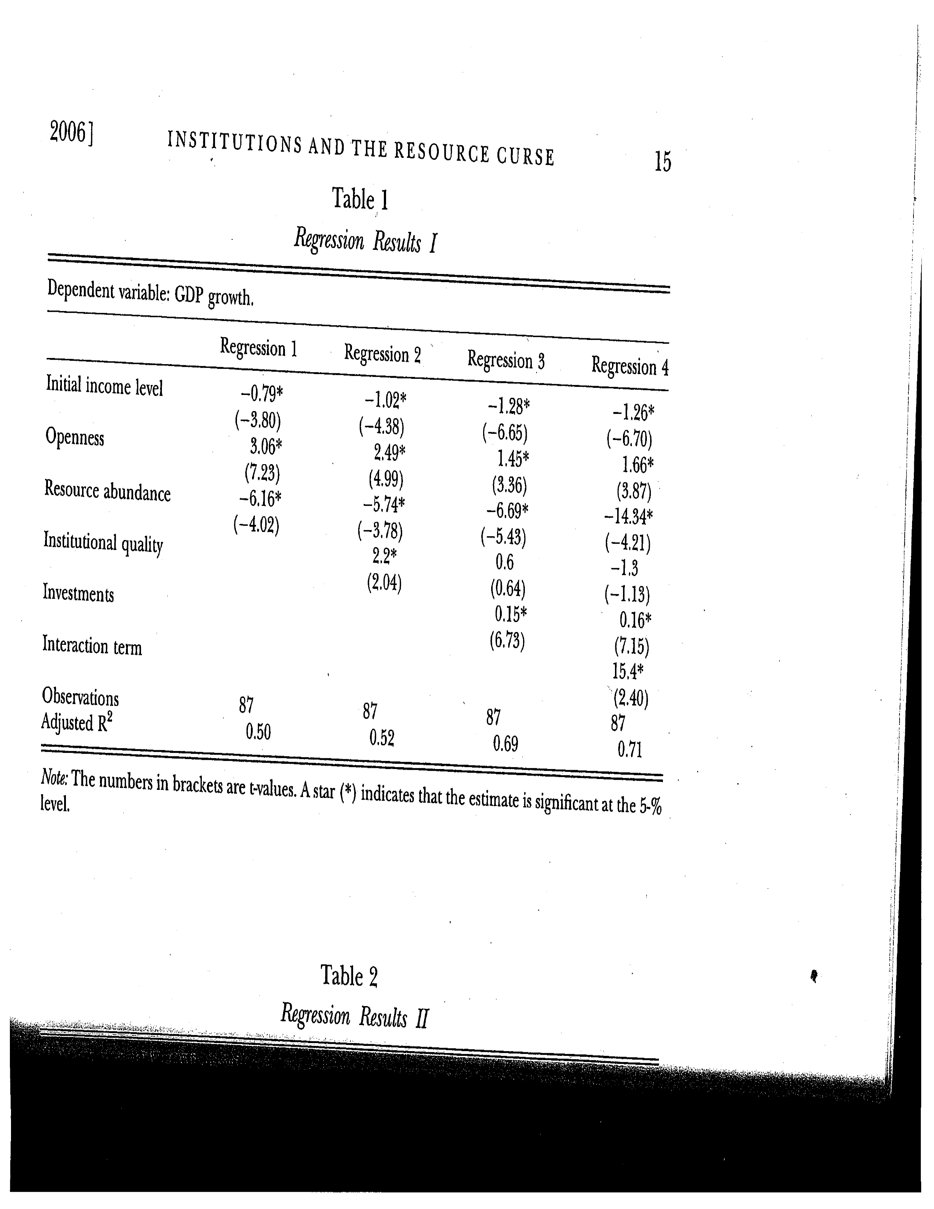

Slide 18
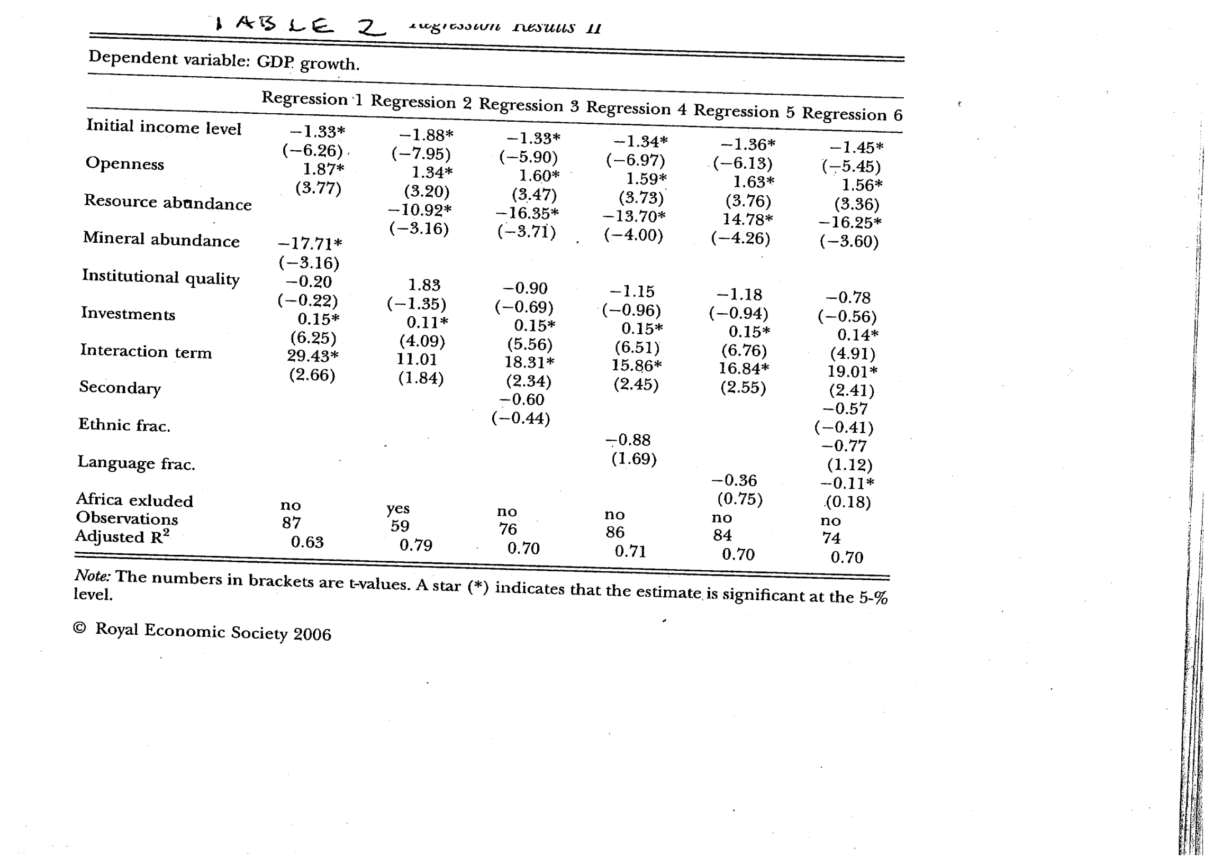

Slide 19
